Slide 1
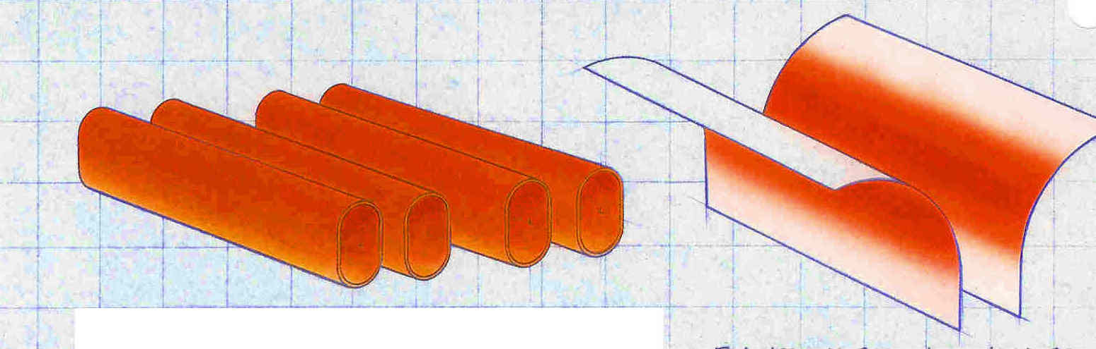


HEAT TRANSFER AREA
TUBE DESIGN
BOTTOM FIRED DESIGN
Heat travels through tubes inside of the tank
Flame is impinged from outside the tank

Slide 2
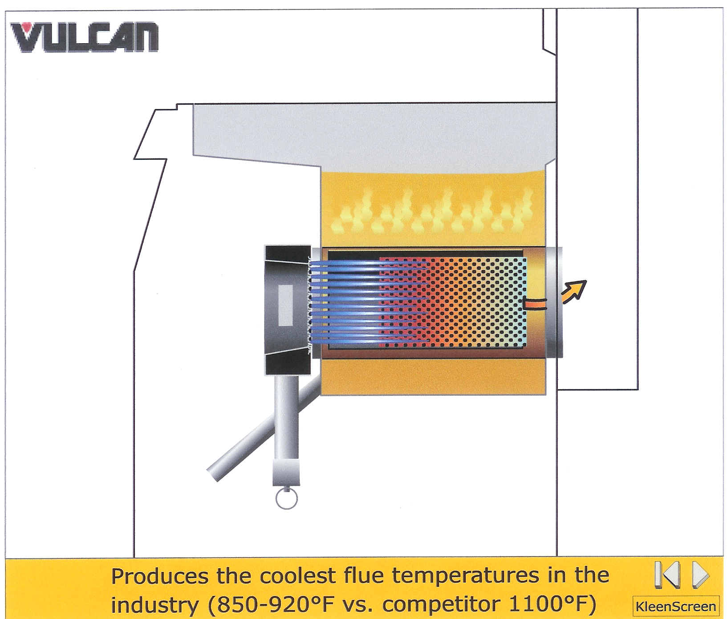
BURNER - FLAME - BAFFLE
Flue
Flue
950-1000F
Burner
Burner
Baffle
Baffle

Slide 3


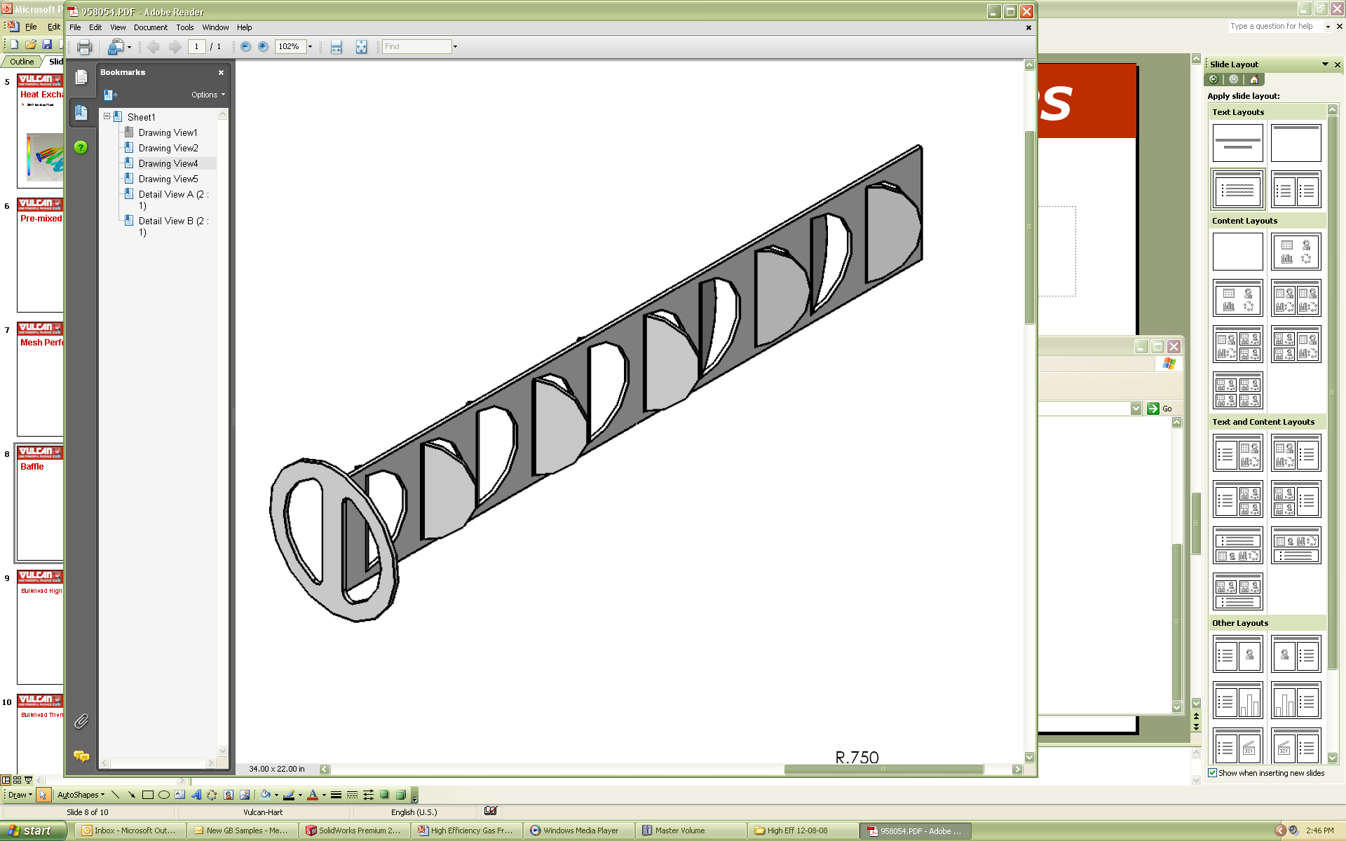
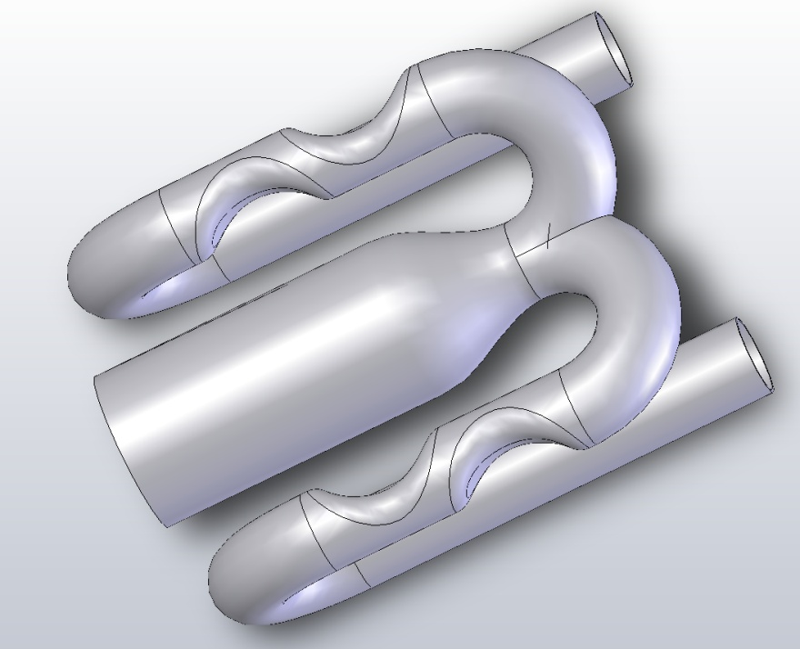
FivePass™ Heat Transfer
3
2
2
1
3
FRONT OF FRYER
444 Stainless Steel
Used to disrupt laminar flow of heat.
Displaces energy before exiting the heat exchange tube.
Heat Exchanger
Uniform Heat Distribution

Slide 4

Total Cost of Ownership
Acquisition costs of equipment
Maintenance and other ongoing costs of equipment
(can be 2 to 20 times greater)
Source: PG&E Food Service Technology Center
Notes:
When comparing equipment, make sure to take into account installation, shipping, maintenance, labor, energy and water, repair costs, and disposal fees. The ENERGY STAR program works to achieve energy efficiency without sacrificing quality in performance.
Remember the acquisition cost of CFS equipment is only the tip of the iceberg in terms of total costs. Restaurateurs often look for the least expensive equipment option on the showroom floor and rarely consider the total cost of ownership of the equipment (which includes the purchase price and lifecycle costs like energy and maintenance). Better made equipment that saves energy and water and lasts longer compensates for initial differences in purchase price.

Slide 5

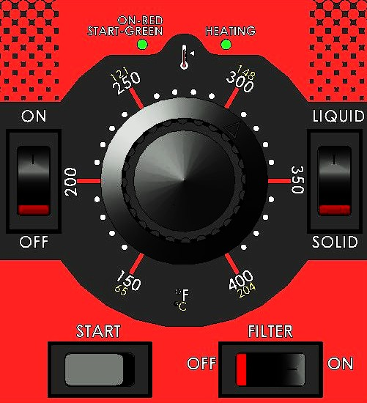
Fryer Controls – Four Different Choices Meeting All of Your Needs:
Millivolt (“M”): (Poor Man’s Control)
  Snap action requiring no electricity
Solid State Analog Knob Controls (“A”):
Accurate Temperatures digital display control
  200°F to 390°F
  Fast Recovery – Reacts within 2°F of set temperature
  Temperature Knob Control
  Two Melt Modes – Solid / Liquid Shortening
  Push Button “One Touch” filtering (KleenScreen PLUS® Only)
  Easy to Use – Easy to Clean

Slide 6
Temperature Curves: Millivolt vs. Solid State
365° F
352° F
350° F
350° F
348° F
335° F
Millivolt Controls
Solid State Controls
Slower Recovery
Less Cook Consistency
No Melt Cycles
Quick Recovery
More Precise Cooking
Includes Melt Cycles

Slide 7

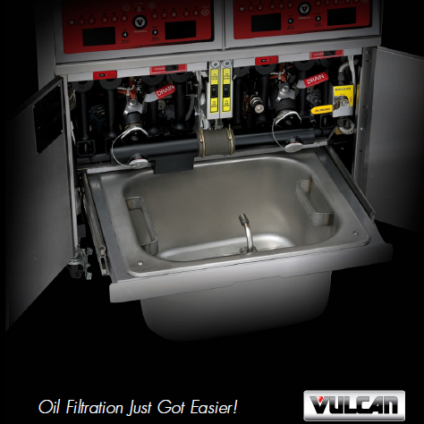


KleenScreen PLUS® Filtration System
Patented Drawer style design
Fabric Filter Envelope , OR
Paperless filter screen
Hands-free operation
Lightweight ( Less than 12 lbs., full assembly )
Large filter pan capacity ( 70 or 110 lbs )
DVI > Drain Valve Interlock Switch
Solenoid Switch Engages the Filter
One Button Touch To Filter a Fryer
Boil Out By-pass Assembly
Oil Reclamation Connections
Filters particulates down to a 0.5 microns

Slide 8
Goal is to Remove as much Particulate as Possible
Filtration Efficiency
Mesh Screen
0.5 Microns
25-30 Microns
Paper
60-80 Microns

Slide 9
Examples of Particle Sizes & Filtration Capability of Paper vs. Fabric
Dirty Oil
Grain of Salt = 60 microns
Ragweed = 20 microns
Cloudy Oil
Flour = 10 microns
Red Blood Cell = 8 microns
Carbon Deposits = .6 microns
Graphite Particle = .5 microns
Clean Oil
PAPER
FABRIC ENVELOPE

Slide 10
KleenScreen PLUS® Savings
Filtration Costs of KleenScreen PLUS® Fabric Filters vs. Paper Filters
Filter Media | Vulcan Fabric Filters | Paper Filters & Powder
Discounted Cost of Envelopes | $15.00 | $1.92
Filter Powder | $0.00 | $0.81
Life of Packaged Amounts (days) | 7 | 0.5
Cost per day | $2.14 | $5.46
Cost Savings With KleenScreen PLUS
Saving per day | $3.32
Savings per week | $23.22
Savings per year | $1,207.44

Slide 11
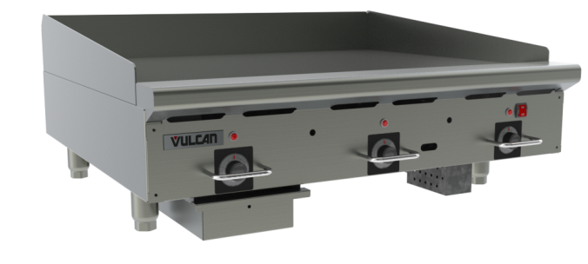
Griddle: It’s a SYSTEM!
PLATE
  Material
  Thickness
  Geometry
HEAT SOURCE
  Gas or Electric
CONTROLS
  Solid State
  Snap Action
  Modulating
  Manual
KNOW YOUR CUSTOMER, THE MENU AND THE APPLICATION
Notes:
11
Griddles are a system composed of three primary parts: PLATE, HEAT SOURCE & CONTROLS
The RRG changes the PLATE: Material, Thickness and Geometry, making it different from all other griddles on the market.

Slide 12
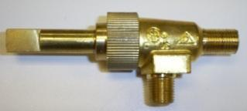
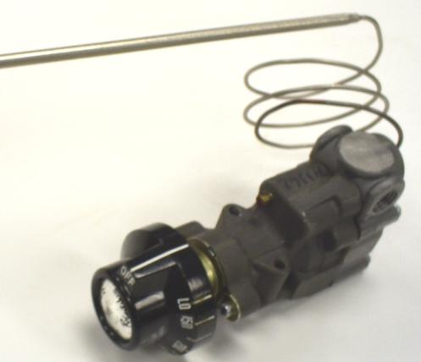
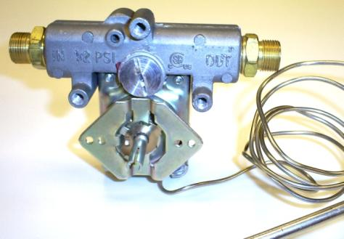
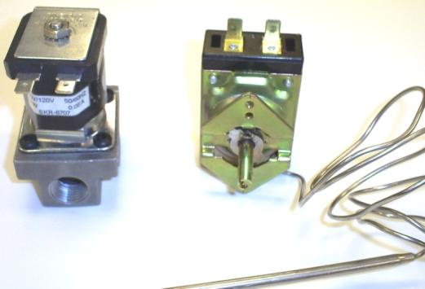
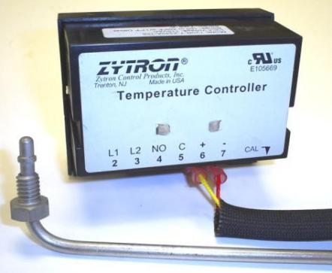
Griddle Temperature Controls
Modulating Gas Thermostat
Manual Gas Valve
Mechanical Snap-Action Thermostat Combo Valve
Solid State Temperature Controller with Probe
Electrical Snap-Action Thermostat + Solenoid Valve

Slide 13
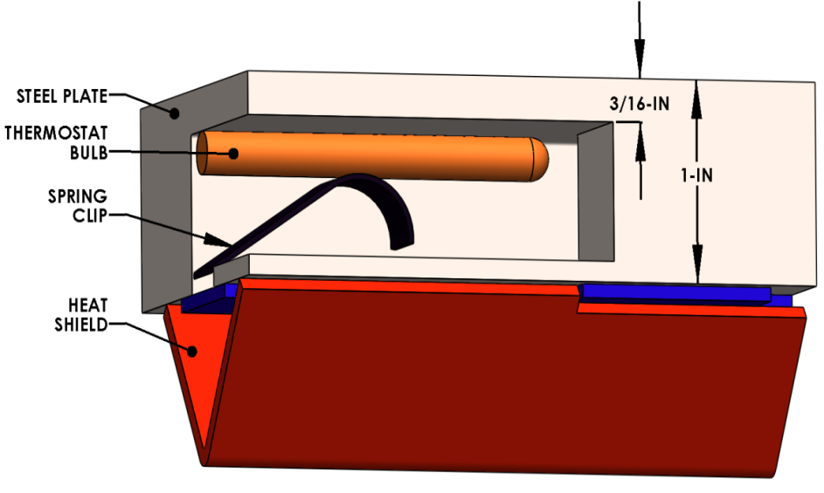
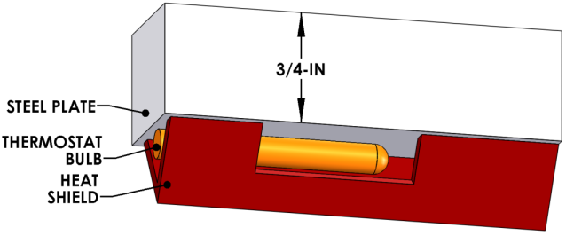
Embedded vs. Bottom Thermostat
Embedded thermostat design offers the most sensitive thermostat response to insure the fastest recovery and tightest griddle temperature control.
Surface mounted thermostats are not as sensitive to temperature change as the embedded design.

Slide 14
Modulating Thermostatic Controls
(aka – Throttling Thermostat)
Competitor’s griddle positioned as “the same as”
American Range ARTG Series
Garland Range CGTT Series
Imperial Range ITG Series
Jade Range JGT Series
Royal Range RST and RSTG Series
Star Mfg. “UltraMax” – 800T Series “StarMax”- 600TD Series
This control is:
  Cheaper
  Offers far less control (than Snap Action)
  Cannot be calibrated effectively

Slide 15








KNOW WHAT THEY SAY…
UNDERSTAND WHAT THEY MEAN!
Check the Spec Sheets for what they say, and what they DON’T say, about the product.
Notes:
If it doesn’t say ‘Snap Action’, it’s a modulating/throttling valve (coarse control)
If it doesn’t say ‘embedded’ or equivalent, it’s bottom mounted
Bottom-mounted throttling thermostat vs. embedded snap-action…sort of like a Jeep versus a Jaguar

Slide 16
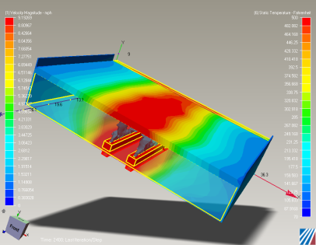
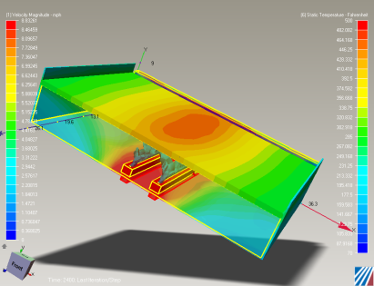
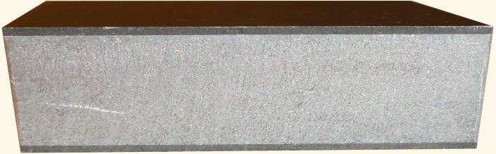
RRG Composite Griddle
Standard 1” Steel Plate
18mm Composite Plate
304 S.S.
Low Porosity = Easy Cleaning
Compare to Chrome!
Vulcan has EXCLUSIVE rights to this material.
ALUMINUM
1/3rd the Weight
5X the Heat Transfer Rate
Notes:
The material – composite of aluminum and 304 S.S., is unique in this application, and has dramatically improved performance over steel.
This material cannot be compared to steel plates “apples-to-apples”. Questions about thickness are irrelevant – it’s too different!
Aluminum transmits heat 5 TIMES faster than steel and is only 1/3rd the weight
304 stainless steel has low porosity, meaning that cleanup is VERY easy.
Customers often choose chrome for the easy cleaning – choose RRG and get most of the benefit but at much less cost. Additional performance is FREE!

Slide 17

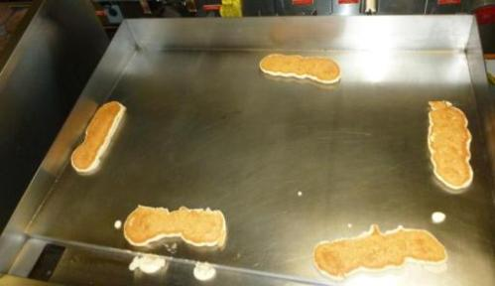
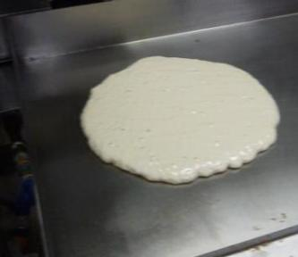
What does this mean to YOU?
In a word: Production.
You can use EVERY SQUARE INCH of this surface for cooking…front-to-back, splash-to-splash.
Oh yeah…and we’re Energy Star rated too.
See our Griddle Pancake Test video on YouTube.com
http://www.youtube.com/watch?v=j2uXErL1YdQ&list=UUMGriCB6pUjpfCHHP_3RyvQ&index=9&feature=plcp
Notes:
These pictures should speak for themselves…the cooking pattern for these pancakes is completely even and consistent.

Slide 18
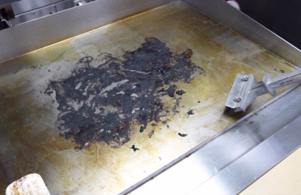
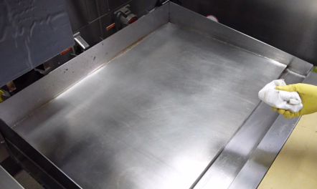
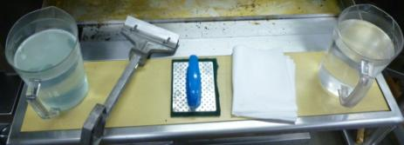
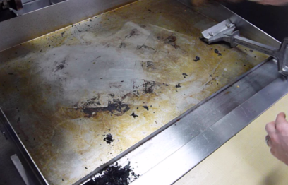
Cleaning under 4 minutes
…a dream come true
Hardened oil/grease
Carbonized BBQ sauce
00:15 sec
03:45 min
3:57 min, start to finish
SOAPY H₂O
SCRAPER
ABRASIVE
PAD
CLEAN TOWEL
CLEAN H₂O
Using nothing but these…
Notes:
304 S.S. has low porosity, which means food doesn’t tend to stick like it does on plain carbon steel plates
Whether grease or carbon buildup, cleaning operations are easy and effective.
Reducing clean-up time will have a REAL impact on daily operations, and even labor costs!
Use this to sell against CHROME plates, which clean with similar ease, but at a MUCH higher cost.
Chrome surface is subject to scratches and damage, requiring special spatulas and cleaning agents.
No special cleaning agents or tools are required for the RRG – use what you already have and rest easy.

Slide 19

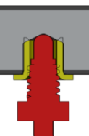
RRG High Performance Griddles
SOLID
STATE
PROBE
SOLID STATE CONTROLS
CORNER-TO-CORNER CONTROL (+/- 12°F)
SST DECK EASY CLEAN + NO SEASONING
40.5% EFFICIENCY at HEAVY LOAD!
49 LB/HR CAPACITY (36RRG)
24” THROUGH 60” SIZES

Slide 20
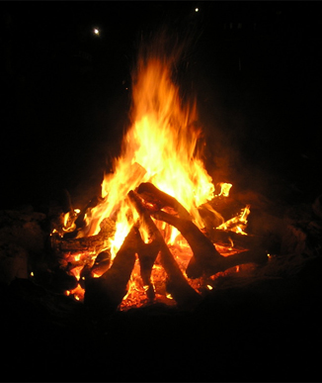
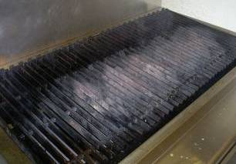
CHARBROILERS – “THE FLAVA THAT YA SAVA”
THE “CAMPFIRE EFFECT” – HEAT PLUME DRAWS HEAT TO THE CENTER
Heat Plume shown by area of “white ash” = Temps over 750F

Slide 21
How VTEC will change your kitchen
Food Quality
  Cooking with TRUE Infrared makes the food juicier, larger & heavier…tastier!
  Uniform zone temperature means under/overcooked food are gone forever.
Operations
  Cook to time! No more ‘babysitting’ the charbroiler…
  Clean-up is a breeze…done in seconds, not hours!
  Ignition at the turn of a dial
  Room temperature to Cook temperature in 15 minutes!
Gas Savings
  Uses ½ the gas of a standard charbroiler – savings you’ll notice!
  Pays for itself in 2-years or less!*
  No standing pilots results in additional savings
*Based on average usage of a standard 48” charbroiler versus a VTEC48.
See www.VulcanEquipment.com/VTEC to calculate your own savings!
Notes:
Outline of major selling points.
Food Quality
- Convective drying is eliminated
- Food retains 20-30% more moisture
- Uniform temperature means you can cook the same ANYWHERE on the surface over a burner.
Operations
- Cooking to time makes operation like a griddle.
- Free up your manpower for other kitchen duties
- Lighting the broiler couldn’t be easier
Gas Savings
- You’ll save a tremendous amount of money. Seriously.
NOTE: this product can be sold effectively to ANYONE who has ANY charbroiler – all of these features and benefits will suit those users.

Slide 22
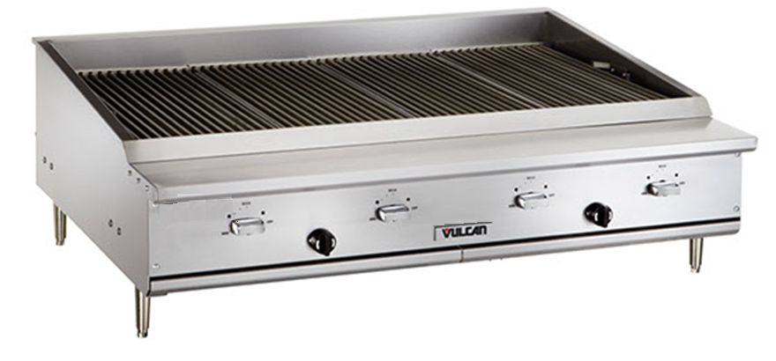
VTEC Design & Construction
11.5”
25”
WIDE RANGE GAS VALVES
ROTARY IGNITORS
1-burner per linear foot (11.5-inch x 25-inch grates)
14, 25, 36, 48 and 60” size options (1-burner up to 5-burners)
Burners rated at 22,000 Btu/hr.
Wide range gas valves. (8,000 Btu/hr at low setting)
No standing pilots - Direct spark rotary piezoelectric igniters.
Notes:
Note that 14” size is a unique offering for this product category. There are very few small charbroilers, and none can be as effective as the VTEC.
Wide range gas valves mean exceptional control of surface temperatures.
Each burner/grate is a SEPERATE ZONE, unaffected by the others. Perfect zone control!
Rotary piezoelectric igniters are durable and easy to use – much better than the red push-button style
Burners must be lit every time they are turned on - no standing pilots will help adhere to many current and developing requirements by industry and municipalities.
We can put piezoelectric igniters on this unit because all of our heat goes in one direction – UP. This is NOT a “campfire in a box”.

Slide 23

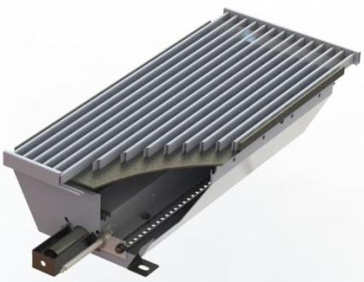
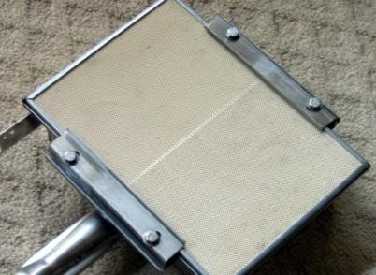
PATENTED BURNER SYSTEM
Ceramic Tile Infrared Burner Technology from 80’s
STAINLESS STEEL GRATE
10GA CARBON STEEL EMITTER PANEL
HIGH EFFICIENCY
304 S.S. BURNER INSIDE A BURNER BOX
No IP Protection
Suitable Only for Over Fired
Broiler Applications.
Non Durable Construction
Fragile
No Protection Against Over Spillage
Patent Protected Design
Suitable for Both Over and
Under-Fired Broiler Applications.
Durable, Reliable All Steel Construction
Shock Proof
Clog-Free Construction
Notes:
When we say ‘infrared’ end users will immediately think about ceramic brick infrared burners.
Our burner is a SYSTEM of parts that generate infrared energy from an emitter panel.
The burner is ALL STEEL, highly durable and free of all the issues one may associate with ceramic burners

Slide 24
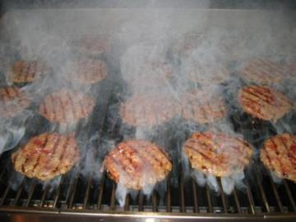
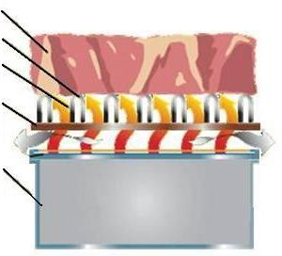
Cooking like never before…
SMOKY VAPOR IMBUES THE FOOD WITH CHARBROILED TASTE
ALL INFRARED MEANS NO CONVECTIVE DRYING!
FOOD RETAINS MOISTURE, STAYING JUICY
¾” S.S. GRATE
100% INFRARED ENERGY FROM PANEL
PATENTED DESIGN
PREVENTS FLARE-UPS
ENHANCES CHARBROILED FLAVOR
NO UNBURNED FUEL/SOOT TASTE
GREAT PRODUCT MARKING
EMITTER PANEL IS HEATED TO 850°F
HIGH EFFICIENCY BURNER HEATS EMITTER PANEL TO A UNIFORM TEMPERATURE
GRATE RESTS ON EMITTER PANEL, ELIMINATING FLARE-UPS
Notes:
Describe how the burner system operates to cook the food.
Grate on the emitter panel means oxygen can’t get in and create flare ups
Smoky vapor envelops the food, imbuing it with flavor

Slide 25





Already the standard…
Temperature profiles based on ASTM 1695-96 test protocols
ACHIEVER CHARBROILER
BAKERS PRIDE
IMPERIAL
MAGIKITCHN
Over 800°F…
enough to melt SOLID ZINC!
Variance of over 400°F in across the cooking grid by some competitors!
Notes:
The Vulcan VACB Achiever Charbroiler has already set the standard for charbroiler performance in the industry.
NOTE: The 650°F ‘sweet spot’ is the target temperature for cooking most proteins.
Remember that ‘hotter’ is not always ‘better’ – food can only absorb heat so fast, so more BTU’s and higher temperature doesn’t translate into more productivity or better food. Like the joke about Thanksgiving turkey – you can’t cook it in half the time at twice the temperature!
Hot spots and cold spots are reason that charbroilers require constant management.
You can literally MELT METAL on some charbroilers – are you using them to cook food or smelt ?

Slide 26
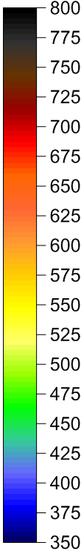
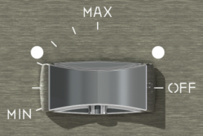



WIDE RANGE VALVES = MAXIMUM CONTROL
112°
MAX
MID
MIN
MAX AVG = 660°F
MID AVG = 460°F
MIN AVG = 370°F
Notes:
Actual lab data
Illustrates the level of control available with our high range valve
Note that normal charbroilers only have a 90-degree valve, only 45-degrees of which is actual ‘control’.
Compared to that we offer 2-1/2 times as much control range for our users.

Slide 27
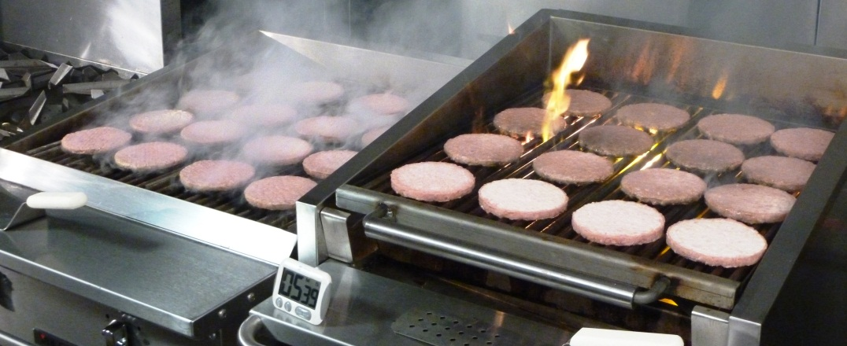
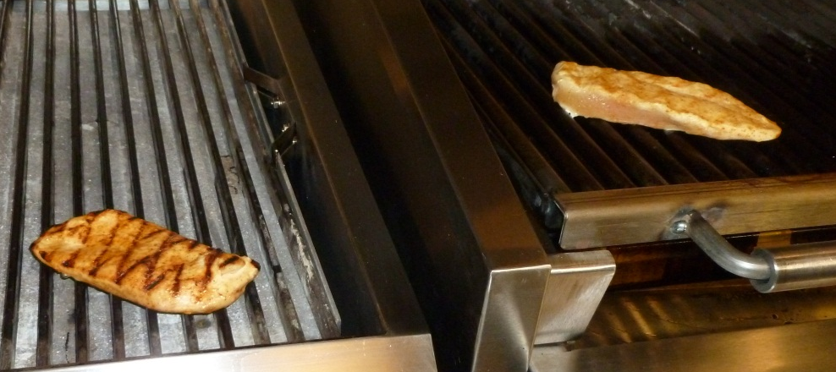
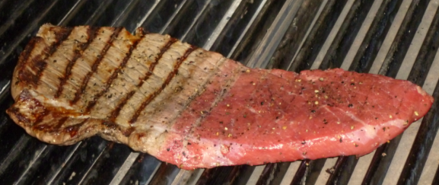
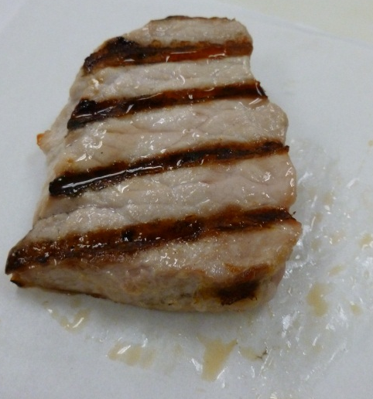
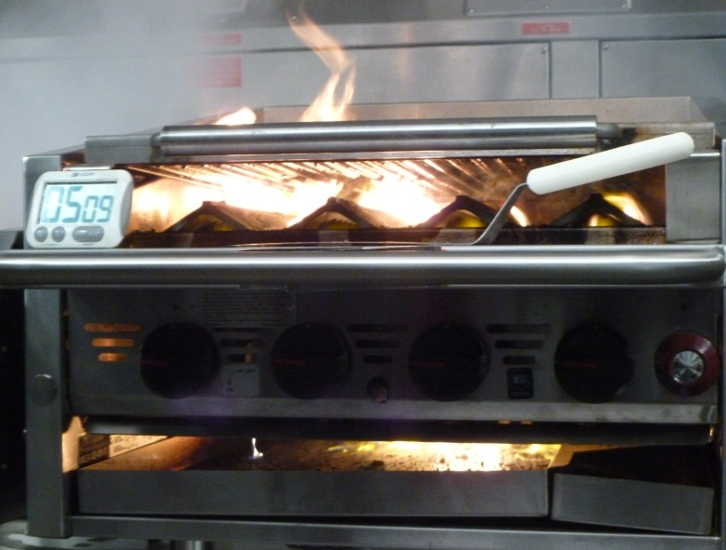
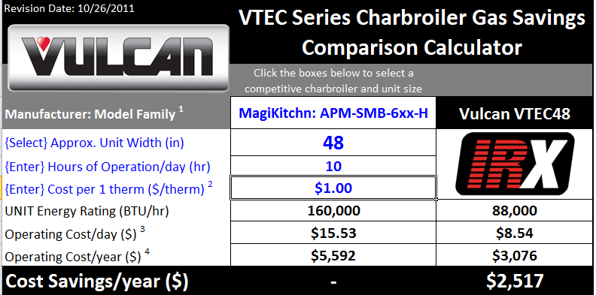
The VTEC difference…
VTEC = SMOKEY VAPOR
VTEC = COOK ANYWHERE
COMPETITOR = FLARE UPS!
COMPETITOR = COLD SPOTS
NOT
RAW!
HOT
Now THAT is Zone Control!
INFRARED =
JUICIER, TASTIER, MORE TENDER-ER…ER
FLARE-UPS AND SECONDARY FIRES ARE SO 20TH CENTURY…
GREEN
GREENER
Notes:
You can cook the same ANYWHERE on the cooking surface…compare THAT to other charbroilers
The food COOKS better, it LOOKS better, it TASTES better.
It’s BIGGER, JUICER and more TENDER
Zone control is unparalleled…seeing is believing
Not saying that you WANT to cook your Well Done at the same time as your Rare, but you COULD…on the SAME STEAK.
Use the VTEC Calculator to show savings to customers: www.vulcanequipment.com/vtec
This will work on your iPad or any smart phone, as well as your computer

Slide 28
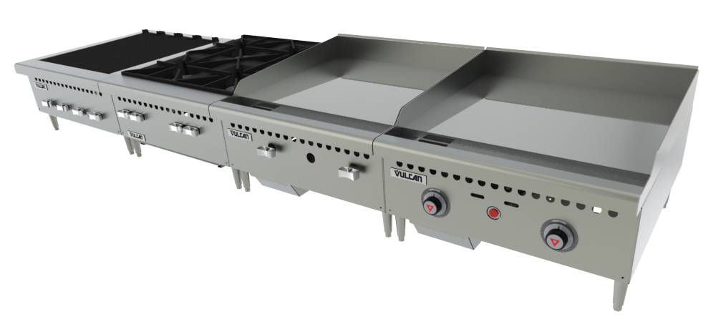
VULCAN Counter Restaurant Series
VCRB VCRH VCRG-M VCRG-T
Based on existing platforms
“Right Sized” for Independent Operators
‘Best in Class’ at target price point
Stock Availability - WYSIWYG
Natural Gas Std. – Conversion Kits (included) for LP applications
VULCAN COUNTER RESTAURANT SERIES

Slide 29
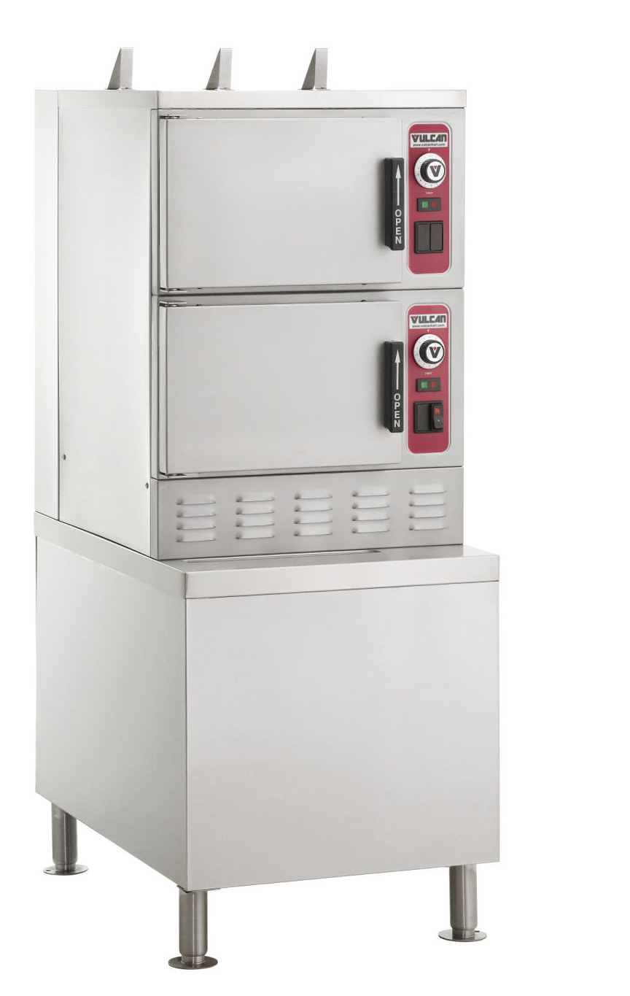
Gas Floor PowerSteamTM
Louvers in front for Gas and cooling air intake –Allows for zero clearance
Hold your Spec with:
Super Heated Steam for faster cooking…
PowerSteam TM
All SST Atmospheric Gas Generator vs. a plate-steel boiler
Fully enclosed (water resistance) base All utilities in rear

Slide 30
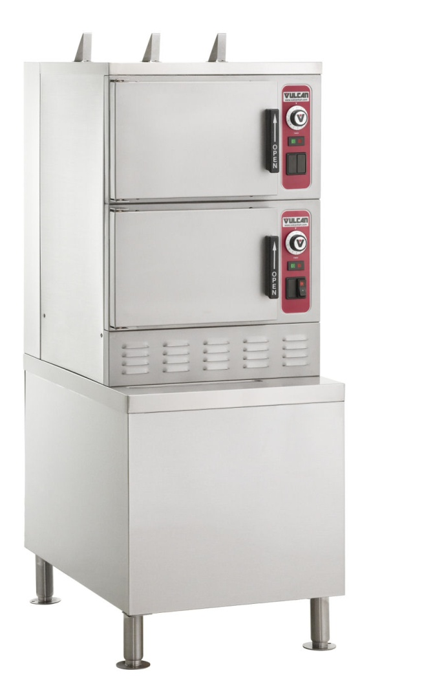
Gas Floor PowerSteamTM
Front breathing –Allows for zero clearance and a SST fully enclosed base (including the bottom)
Super Heated 235 F Steam for faster cooking (Reliable)
Simple User Interface with… Water resistant controls
Staged filling doesn't kill the boil :
No recovery –time, pre-heat ...or.......... load- compensation needed

Slide 31
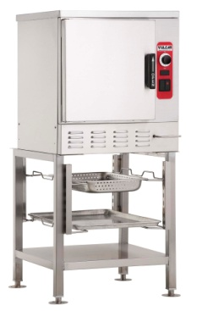
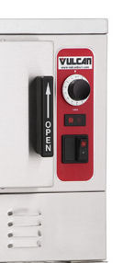
ELECTRIC Counter PowerSteamTM
SUPERHEATED PROFESSIONAL & BASIC MODEL with:
Spanned electrical voltages
  208v single phase
  208v three phase
  240v single phase
  240v three phase
  (all in ONE machine)
Basic Model that lists for $1000 less to help up-sell the end-user to a professional model
Professional Model

Slide 32
Electric Professional Countertop
Superheated Steam for faster cooking
Staged water fill doesn't kill the boil
(No Recovery Time or Load Compensation Needed)
Mineral tolerant electric generator with smart drain and power flush
Simple User Interface
(Lighted power switch)
  On with Staged Generator Fill
  Off for Auto Drain
  Ready and Cook light

Slide 33
OUR GENERATOR is much more Mineral Tolerant …
Designed for TODAY’s Water Quality
Power Flush
Drain Jet
Generator 3D models
Slope Bottom
Motorized Ball Valve

Slide 34
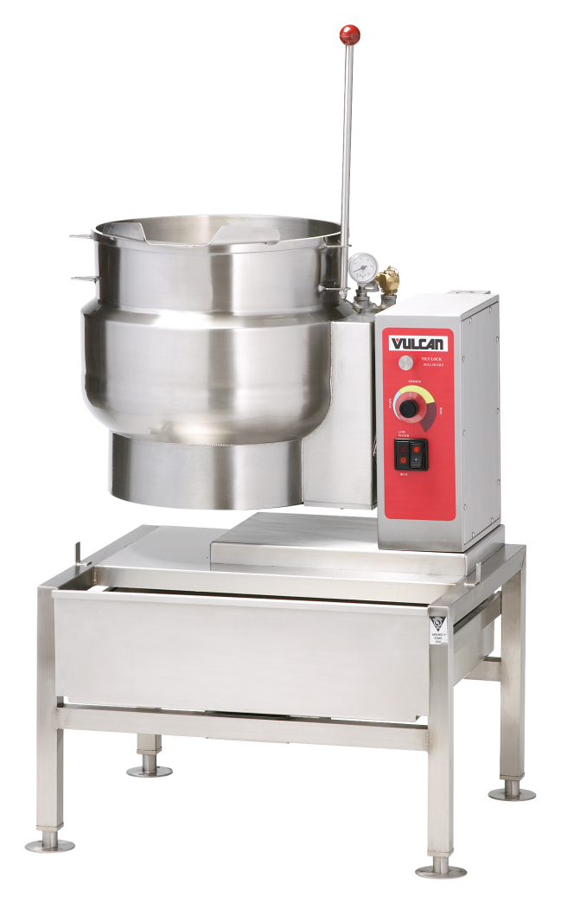
Vulcan Steam Jacketed Kettles
Designed and Manufactured in Troy, Ohio
Energy savings: Vulcan kettles provide excellent heat transfer.
  Spanned electric voltages
    208 single phase
    208 three phase
    240 single phase
    240 three phase
  Solid bar lip

Slide 35
Vulcan Steam Jacketed Kettles
Designed and Manufactured in Troy, Ohio
Energy savings: Vulcan kettles provide excellent heat transfer.
  Solid bar lip
  Full working capacity with embossed gallon/liter markings (6gal = 6gal not 5.8 gal.)
  Simple & Intuitive User Interface
  (Warm, Simmer, Boil)

Slide 36
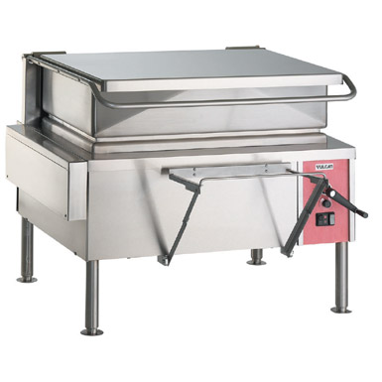
Vulcan Steam Braising Pans
Designed and Manufactured in Troy, Ohio
Cool to the Touch Handle….Doesn’t Warp the lid when lifted from the sides or corner
Pitcher style Pour spout
Pan Support and Strainer are Standard with the unit
Lid stays where you stop it when lifted or closed
Allows for vented cooking without a messy vent cap on top of the lid
Continuous drive mechanism will not break when over-cranked

Slide 37
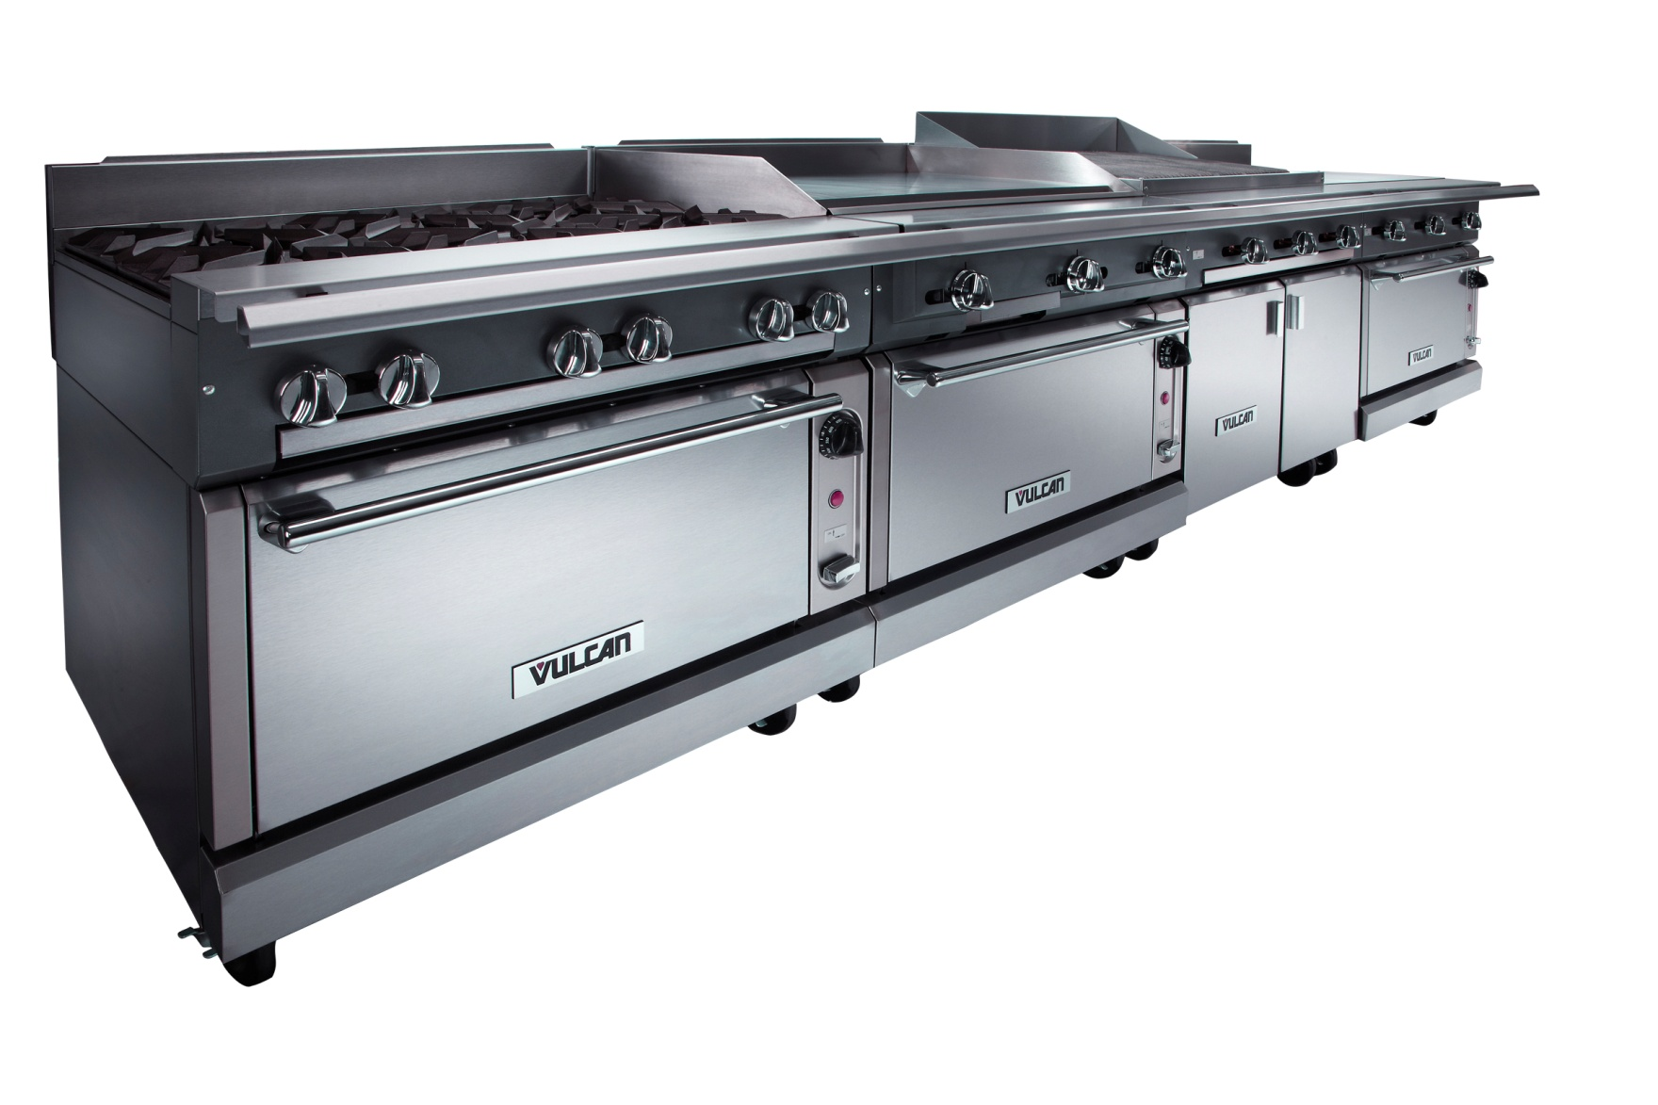
Heavy Duty V-Series Range

Slide 38
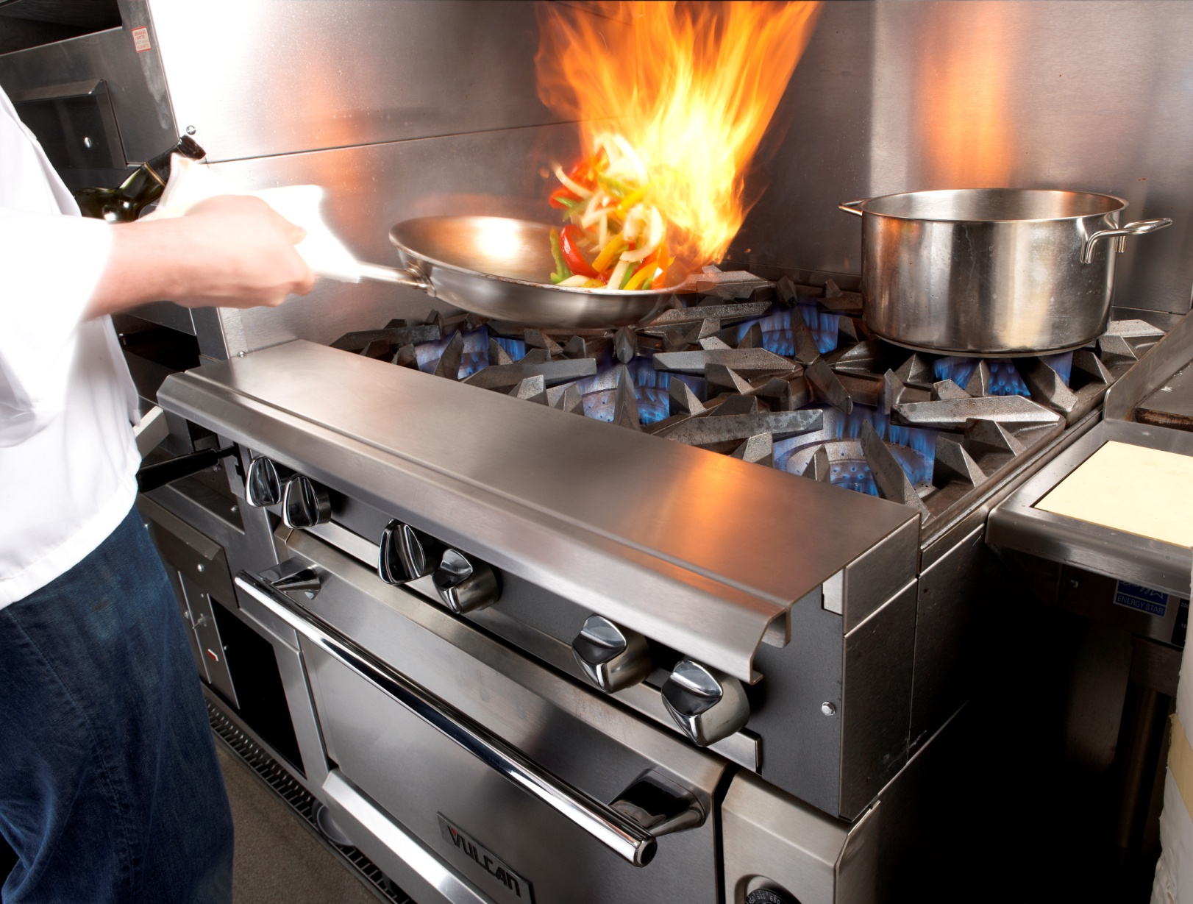
What does the customer want in a range?

Slide 39
Factors that determine burner performance
BTU’s
Burner size and shape and how it is ported
Distance from burner to bottom of grate
Grate design and material mass
Aeration bowls

Slide 40
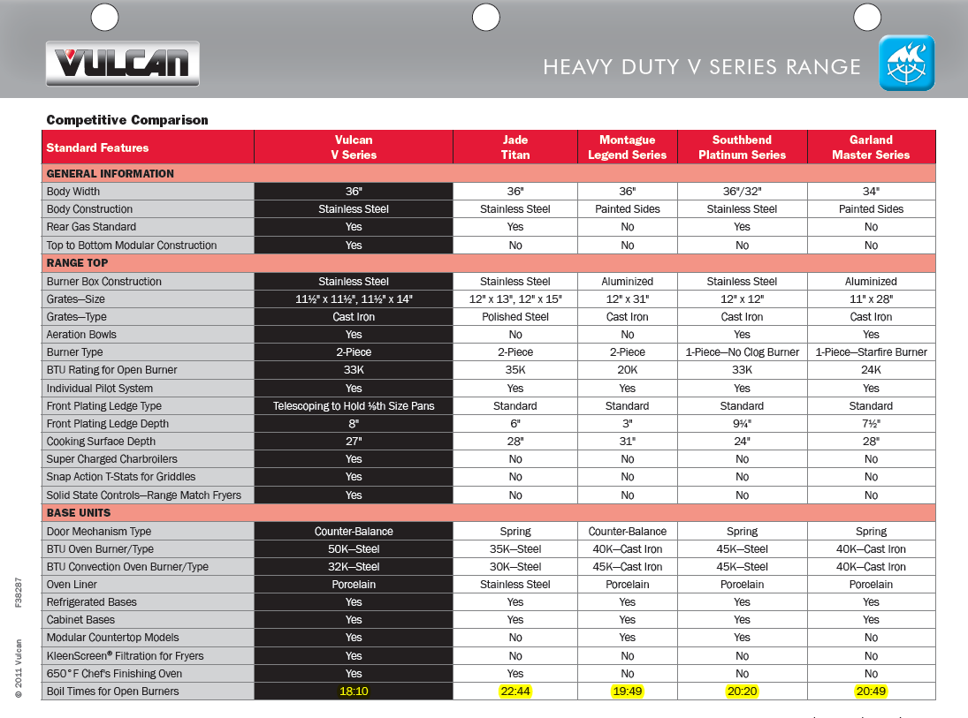

Slide 41
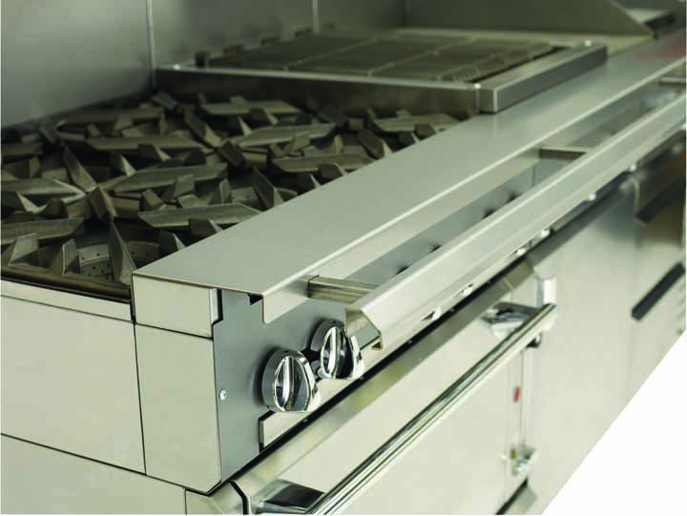
Telescoping Condiment Rail Standard

Slide 42
Features and Benefits of 650 degree Oven vs. a Convection Oven
Higher temperatures with a standard oven
  650 degrees vs. 500 degrees
  maintain perfect moisture levels and cause less shrinkage
Fast recovery
  Burner remains on since it is a standard oven
  Griddle plate retains heat in oven cavity
Lower initial cost
  $1680 list price
  Convection oven upcharge is @ $3800 list price
Lower cost of ownership
  No switches or motors to fail due to high heat environment.
  Years of reliable service

Slide 43
Key Take Away Points – HD Ranges
Enhanced Visual Aesthetic
  High polish metal knobs and handles
  Crisp, sharp lines for display cooking appeal
Unequaled versatility
  Modularity, top and bottoms can be mixed anytime.
  Flexibility in design
  Ease of installation
  After installation modification
Superior performance top to bottom and left to right
  33,000 BTU 2 pc. open burners w/ aeration plates and cast grates
  S.S. crumb tray, burner boxes and range bottoms
  50,000 BTU standard oven. 32,000 BTU convection oven
  Reliable counter balanced door mechanism vs. tension spring
  Even heat and French Tops
  Supercharged Charbroilers
  Griddle can be mounted left or right on the range
  Mechanical Snap Action thermostats for precise temp. control
  Plancha griddles
  Fryers with built-in Kleen Screen filtration
  Traulsen refrigeration on refrigerated bases

